Slide 1

Chapter 8
Address
Resolution
Protocol
(ARP)
TCP/IP Protocol Suite
Copyright © The McGraw-Hill Companies, Inc. Permission required for reproduction or display.

Slide 2
8-1 ADDRESS MAPPING
The delivery of a packet to a host or a router requires two levels of addressing: logical and physical. We need to be able to map a logical address to its corresponding physical address and vice versa. These can be done using either static or dynamic mapping.
TCP/IP Protocol Suite

Slide 3
Topics Discussed in the Section
Static Mapping
Dynamic Mapping
TCP/IP Protocol Suite

Slide 4
8-2 ADDRESS MAPPING
Anytime a host or a router has an IP datagram to send to another host or router, it has the logical (IP) address of the receiver. But the IP datagram must be encapsulated in a frame to be able to pass through the physical network. This means that the sender needs the physical address of the receiver. A mapping corresponds a logical address to a physical address. ARP accepts a logical address from the IP protocol, maps the address to the corresponding physical address and pass it to the data link layer.
TCP/IP Protocol Suite

Slide 5
Topics Discussed in the Section
Packet Format
Encapsulation
Operation
Proxy ARP
TCP/IP Protocol Suite

Slide 6
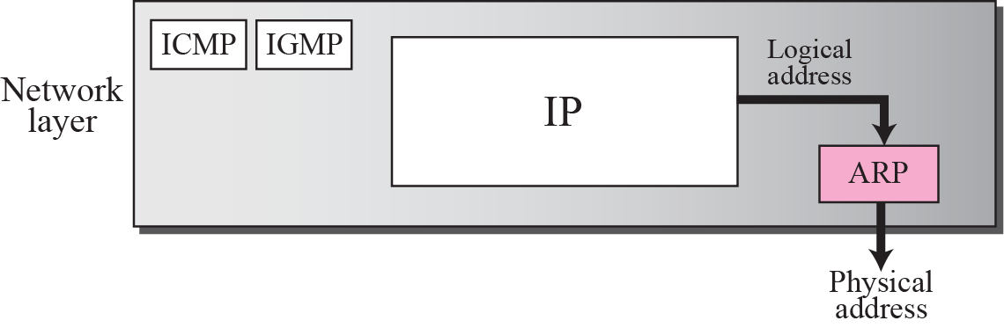
Figure 8.1 Position of ARP in TCP/IP protocol suite
TCP/IP Protocol Suite

Slide 7
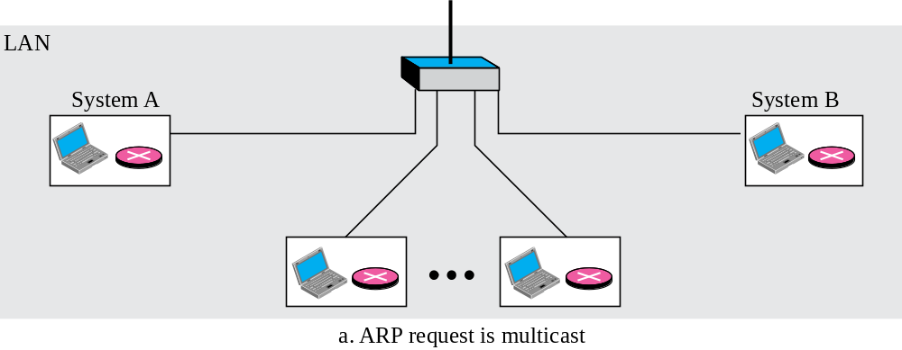
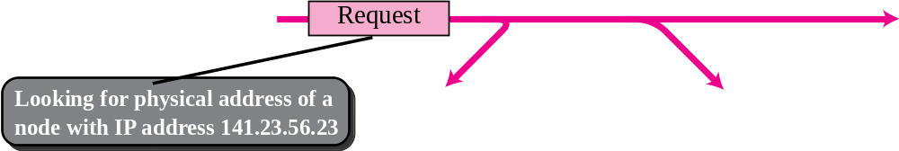
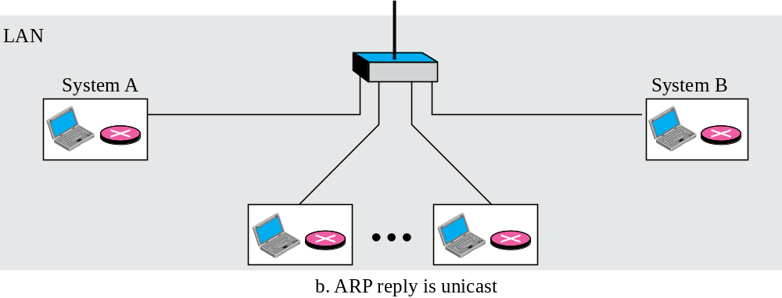
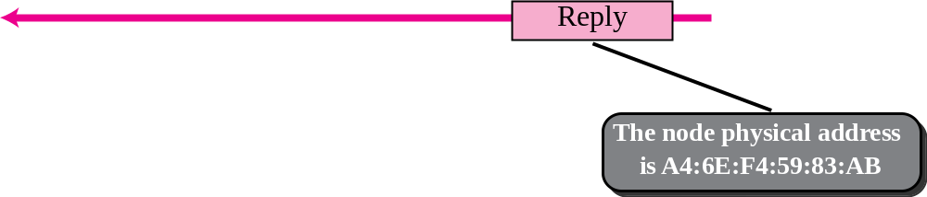
Figure 8.2 ARP operation
broadcast
TCP/IP Protocol Suite

Slide 8
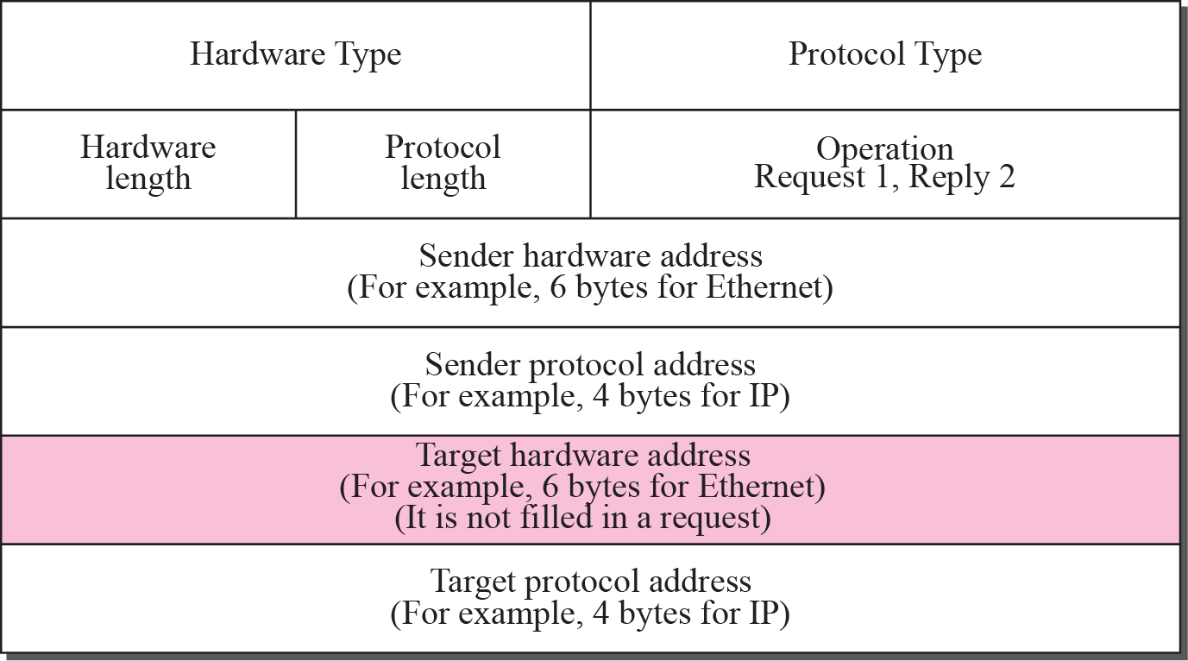
Figure 8.3 ARP packet
TCP/IP Protocol Suite

Slide 9
1- Hardware type: This is a 16-bit ﬁeld deﬁning the type of the network on which ARP is running. Each LAN has been assigned an integer based on its type. For example, Ethernet is given the type 1. ARP can be used on any physical network
2- Protocol type: This is a 16-bit ﬁeld deﬁning the protocol. For example, the value of this ﬁeld for the IPv4 protocol is 0800. ARP can be used with any higher-level protocol.
3- Hardware Length: This is an 8-bit ﬁeld deﬁning the length of the physical address in bytes. For example, for Ethernet the value is 6.
4- Protocol Length: This is an 8-bit ﬁeld deﬁning the length of the logical address in bytes. For example, for the IPv4 protocol the value is 4.
TCP/IP Protocol Suite

Slide 10
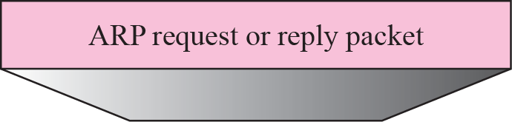
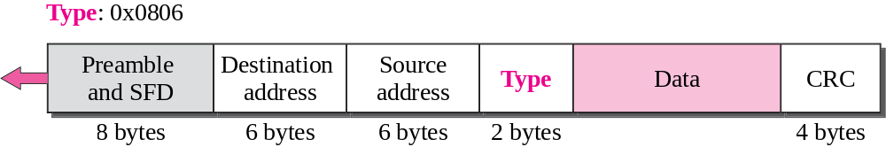
Figure 8.4 Encapsulation of ARP packet
TCP/IP Protocol Suite

Slide 11

Note
An ARP request is broadcast;
an ARP reply is unicast.
TCP/IP Protocol Suite

Slide 12
Example 8.1
A host with IP address 130.23.43.20 and physical address B2:34:55:10:22:10 has a packet to send to another host with IP address 130.23.43.25 and physical address A4:6E:F4:59:83:AB. The two hosts are on the same Ethernet network. Show the ARP request and reply packets encapsulated in Ethernet frames.
Solution
Figure 8.6 shows the ARP request and reply packets. Note that the ARP data field in this case is 28 bytes, and that the individual addresses do not fit in the 4-byte boundary. That is why we do not show the regular 4-byte boundaries for these addresses. Also note that the IP addresses are shown in hexadecimal.
TCP/IP Protocol Suite

Slide 13
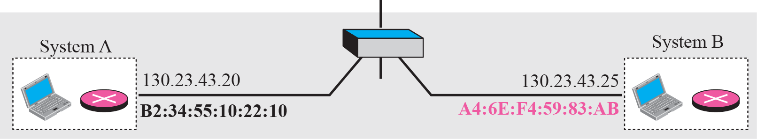
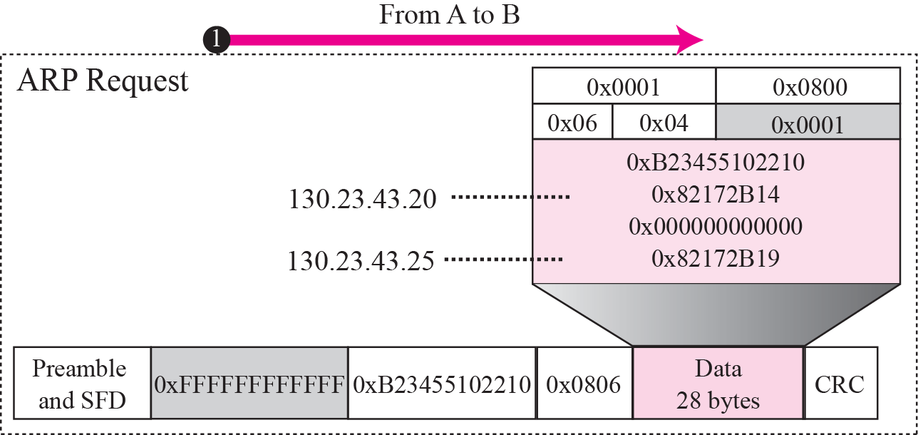
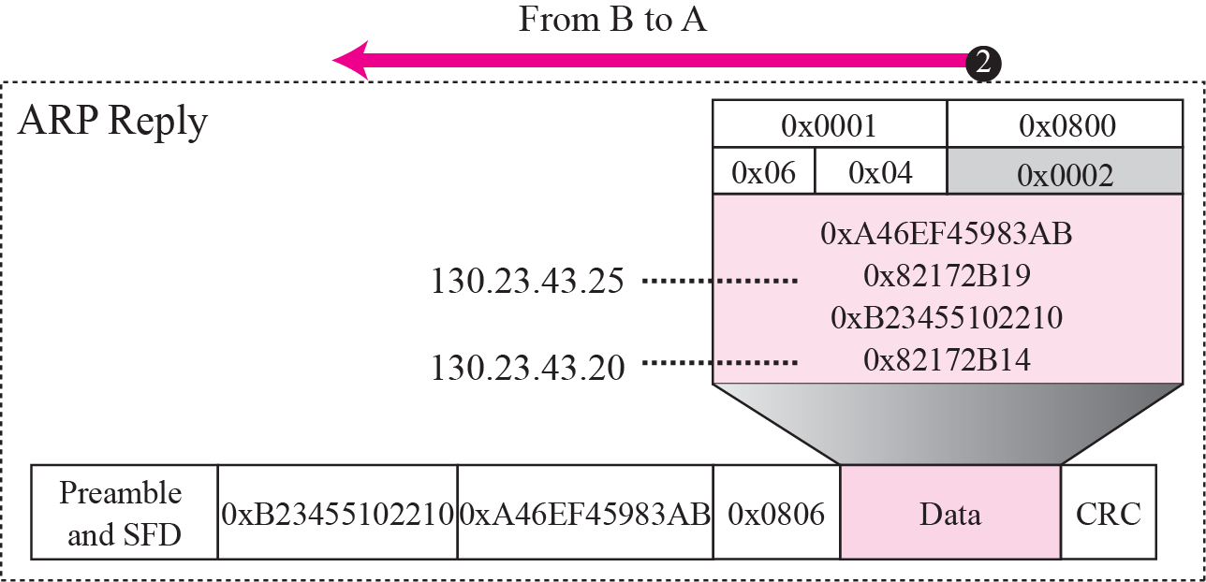
Figure 8.6 Example 8.1
TCP/IP Protocol Suite

